Slide 1
Parents are the best teacher?
황준화
Notes:
Hello my name is 황준화. I will introduce why parents are the best teacher.

Slide 2
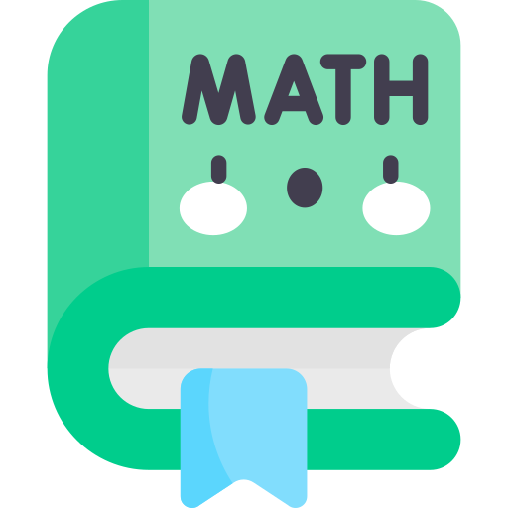
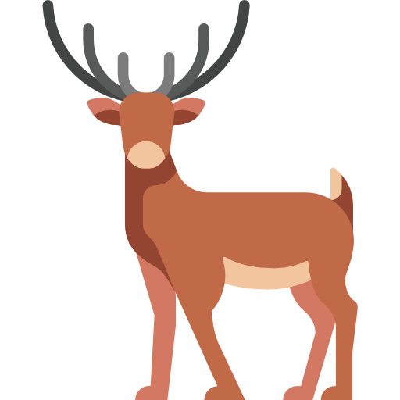


Introduction
ENGL
SCIE
Notes:
Today, students learn many thing with many teachers. They teach math, English, Korean so on for CSAT. But students are having very hard because this. Here an idea, parents are the best teacher.

Slide 3
Index
Parents know student well
Students free of the exam stress
Right study makes right person
Notes:
나열되는 요소

Slide 4

Parents know student well
Notes:
Parents know more about students than teachers. Therefore, it is possible to teach students the necessary knowledge correctly.

Slide 5

Students free of the exam stress
Notes:
Students get stressed out because of the CSAT and other tests. Parents can get away with it to some extent.

Slide 6
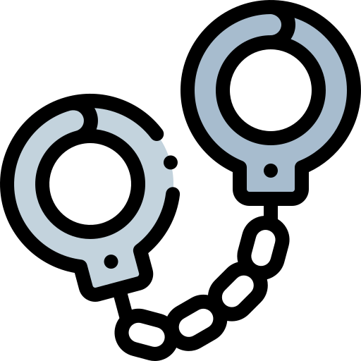
Right study makes right person
Notes:
Students did not learn ethics or ethics correctly because they were studying for exams such as math and English when they were young, and most of them ended up being criminals or unemployed.

Slide 7
Thank you for listening
황준화
Notes:
마침

